Slide 1
Report on Computer Network Course Practice
{
Student ID: 1820259055
Name: Zendel Aleksei (阿列克谢)
Date: 2025.10.11
}
...

Slide 2
Requirements
{
It is required to design and implement a multi-threaded online chat platform with:
instant messaging,
file transfer,
collaborative editing,
role management.
}
..

Slide 3
Analysis
{
Messaging must support sending text messages from one user to another or to multiple, while storing the conversation history. For messaging to be instant, sockets have to be used.
The application must support transferring files between users.
The application must let users share files for collaborative editing.
}

Slide 4
Design
{
Server side will listen for and accept incoming client connections.
Client will be able to connect to the server via an internet browser.

Slide 5
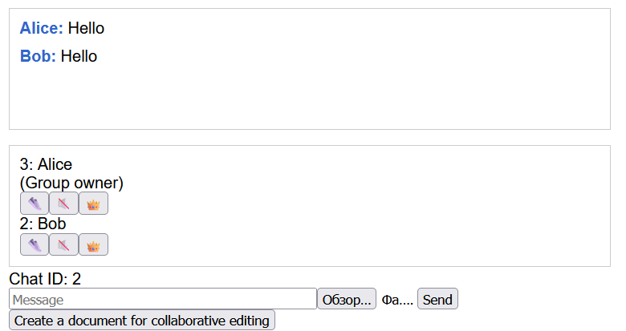
Design
After authorization, users will be able to see their chats, and create new chats.

Slide 6
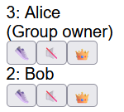
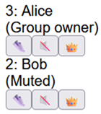
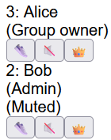
Design
Chats support several roles:
Normal user (no privileges)
Administrator (has management rights over normal users)
Group owner (has management rights over everyone)

Slide 7
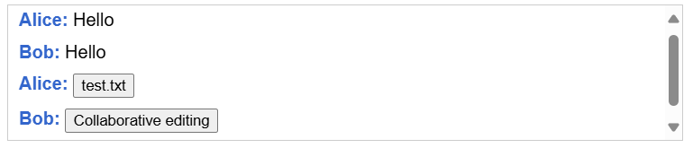
Design
In a conversation, users will be able to send text, files for downloading and files for collaborative editing.

Slide 8
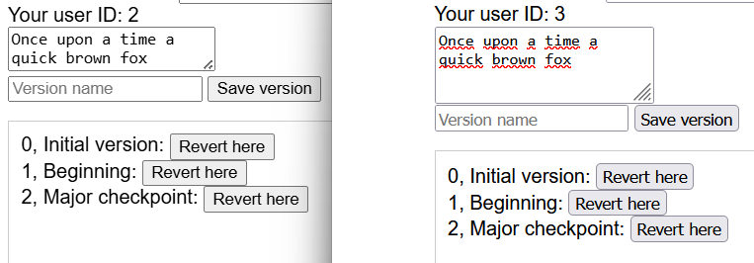
Design
Collaborative editing will let different users edit a file together and make snapshots of it. The file state will be able to be reverted to any of the snapshots.
}

Slide 9
Development and implementation
{
Server is written in Go. A client can interact with the server through webpages. They can send each other text messages about new events in JSON format via websockets. The project uses TLS-encryption.

Slide 10
Development and implementation
Client
HTTP request for the authorization page
Server
Authorization page
Credentials
Cookie
HTTP request for the chat page (with the cookie)
Chat page
Websocket communication

Slide 11
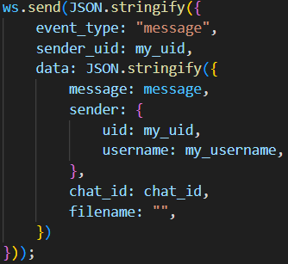
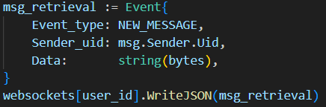
Development and implementation
Below are examples of server-to-client and client-to-server communications respectively.

Slide 12
Development and implementation
File transfer
Chat retrieval
To transfer files, base64-encoding is used.
All messages and files are saved on the server-side so that they can be retrieved by users logging in in the future.
}

Slide 13
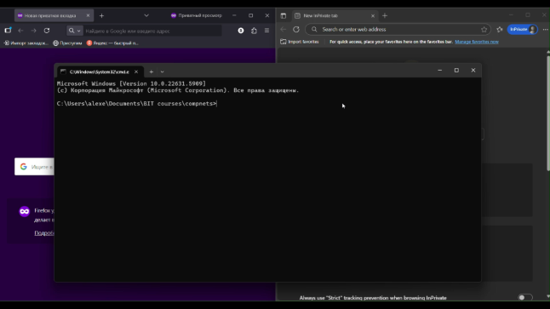
Usage example
{
}

Slide 14

Usage example
{
}

Slide 15
Performance
{
For testing both HTTP requests and websocket connections k6 was used.
First experiment consisted of concurrently registrating users, creating new group chats with a different user and sending them three messages. Due to concurrency, the server started failing more often than not once the amount of users exceeded 100.

Slide 16
Performance

Slide 17
Performance
Second experiment has been conducted by transferring files between clients and the server.
}

Slide 18
Thanks!

